Slide 1

Bondho Janala E-commerce
Submitted By:
MD QUANET UL AHKAM ROKON (20-43582-1)
MD. OMAR FARUK FAISAL (20-43669-2)
SHAKIBUL ISLAM AKASH (20-43861-2)
Submitted To:
DR. MOHAMMAD RABIUL ISLAM

Slide 2

PROBLEM DOMAIN
Background to the Problem
Rapid technology advancements have reshaped shopping behaviors.
Customers seek convenient, time-efficient online shopping experiences.
Vendors strive for maximized profits through efficient operations.
Solution to the Problem
Develop an E-commerce web application for seamless online shopping.
Enable customers to access, select, and pay for products instantly.
Enhance vendor efficiency and sales through a user-friendly platform.

Slide 3

SOLUTION DESCRIPTION
Homepage:
Quick search option for efficient item search.
Login button for customer access.
Customer Registration:
Easy customer registration with essential details.
Secure password reset option.
Vendor Management:
Vendor login to update and manage customer information.
Logout and homepage navigation options.
Product Interaction:
Upload file option for custom product requests.
Quantity check, availability status, and item selection.
Secure Payments:
Encrypted credit/debit card payment processing.
Stringent security measures to safeguard customer data.

Slide 4
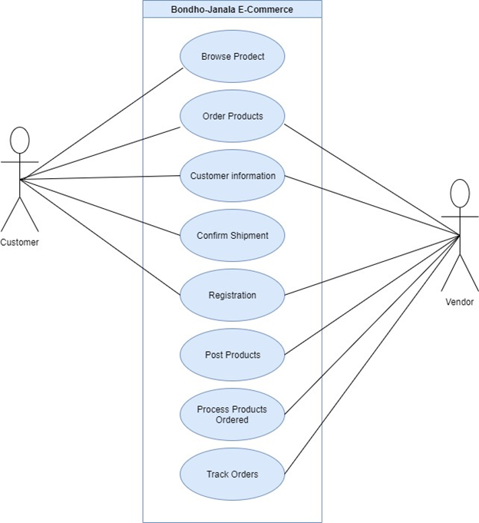
UML Diagrams

Slide 5
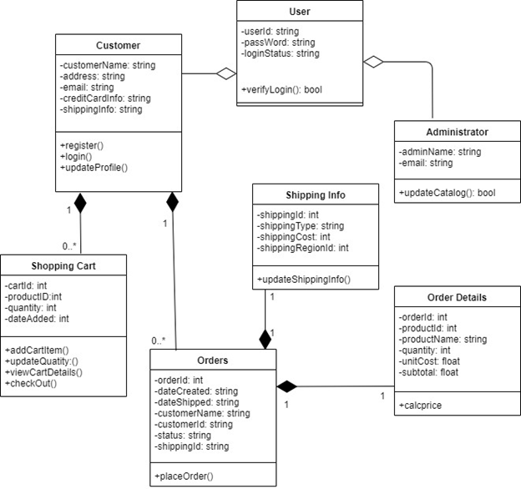
Class Diagram

Slide 6
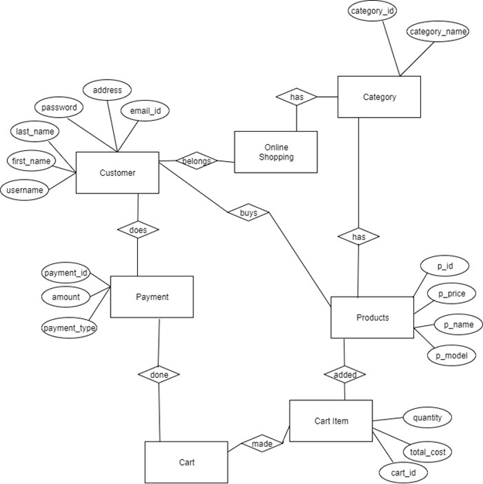
ER Diagram

Slide 7

Social Impact
"Bondho Janala E-commerce Project"
Enhanced Access to Goods
Improved Convenience
Vendor Empowerment
Transparency and Trust
Digital Literacy and Inclusion
Feedback-Driven Improvement
Job Creation and Economic Impact
Reduced Environmental Footprint

Slide 8

Development Plan with Project Schedule
The development plan includes:
Requirement Analysis
Web Design
Prototype Production
Testing and Quality Assurance
Implementation
Training for employees
Maintenance
Marketing

Slide 9
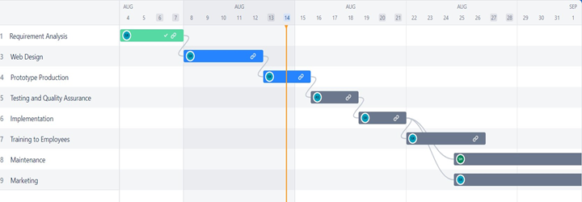

Slide 10
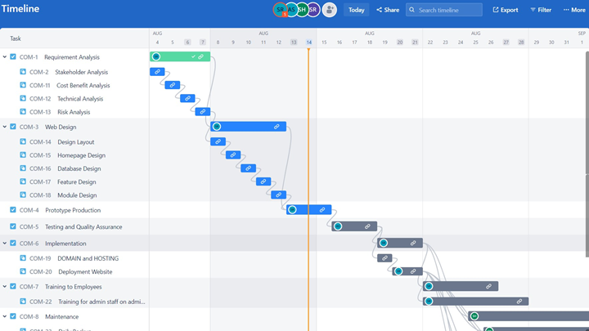

Slide 11

Marketing Plan
Short-term marketing plan: Short-term marketing plans are created to meet immediate needs. These types of strategies usually don’t last very long because they are only designed to give a temporary boost. Short term marketing techniques include:
Direct mail
Print ads
Billboards
Outdoor advertising
Telemarketing etc.
Long-term marketing plan: A long-term marketing plan is a comprehensive plan that helps one achieve his larger business objectives. This type of marketing strategy involves planning so that one knows what he is going to do next. The long-term marketing activities include:
SEO
Content Marketing Initiatives
Social Media

Slide 12
Long Term Marketing Plan
SEO: Search Engine Optimization (SEO) is a long-term marketing strategy that may take months or even years to implement, but it is the best source of B2B prospects. Understanding SEO is a lifelong process that demands practice.
Content marketing Initiatives: Content marketing is a strategic marketing approach focused on creating and distributing valuable, relevant, and consistent content to attract and retain a clearly defined audience — and, ultimately, to drive profitable customer action.
Social Media: Social media can be utilized to accomplish ongoing goals as well as short- and long-term ones. In the short term, it can be used to monitor and manage your internet reputation. Social media can be used to continuously engage in online communities, spread knowledge, and support efforts that provide benefits.

Slide 13
Cost and Profit Analysis
Service | Daily cost (BDT) | No. of Days | Total cost (BDT)
Website Design/Graphics | 5250 | 6 | 31500
Front-end developer | 800 | 10 | 8000
Back-end developer | 1000 | 20 | 20000
Quality Assurance | 5250 | 4 | 26250
Business Analyst | 2200 | 30 | 66000
Cloud Hosting | 130 | 60 | 7800
eCommerce Website Maintenance | 780 | 60 | 46800
SEO | 3120 | 52 | 162240
Advertising cost |  |  | 80,000
Overhead cost |  |  | 28410
Total cost |  |  | BDT 477000

Slide 14

Profit Analysis:
Almost 60 days have been appointed to complete the software. By summing up all the costs, it becomes 477000 (BDT).
The client needs to pay 30,000 for the website. They will get the full website at this price.
The first month of website support is free, then it will cost 2000 per month. So, in a year the support cost will be, (2000*11)=22,000.
Among 100 business owners, 70 of them are expected to use the eCommerce site. So, expected payment is (70*30000)+(70*22000)=3640000.
If the total cost is deducted then the profit for the year is: 3640000 - 477000 = 3163000 (BDT)

Slide 15

Reference
https://www.diagrameditor.com/webapp/?splash=0&ui=atlas&tr=0&gh=0&gl=0&gapi=0&od=0&db=0&lang=en
https://e-commerce2022.atlassian.net/jira/core/projects/COM/issues/?filter=allissues
https://e-commerce2022.atlassian.net/jira/core/projects/COM/timeline?timelineMode=WEEKS
https://www.outerboxdesign.com/web-design-articles/ecommerce_website_pricing

Slide 16
THANK YOU

